Slide 1
OOP Principles
@TEAMNET.RO

Slide 2
Outline(1)
What is Object-oriented programming?
OOP basic concepts
2.1 Objects
2.2 Classes
2.3 Packages
2.4 Access modifiers
2.5 Constructors
2.6 Interfaces
2.7 Abstraction

Slide 3
Outline(2)
2.8 Encapsulation
2.9 Inheritance
2.10 Polymorphism
2.11 Method Overloading
2.12 Method Overriding
3. D.R.Y. principle
4. Immutable objects

Slide 4

What is Object-oriented programming?
1

Slide 5
What is Object-oriented programming?
Object-oriented programming (OOP) is a programming paradigm based on the concept of “objects”, which are data structures that contain data, in the form of fields and code, in the form of methods.

Slide 6
OOP basic concepts
2

Slide 7
Objects
2.1

Slide 8
Objects
Class Object is the root of the class hierarchy in Java.
Look around right now and you'll find many examples of real-world objects: your dog, your desk, your television set, your bicycle.
Real-world objects share two characteristics: They all have state and behavior.
Notes:
Driver Manager ➔The first driver that recognizes a certain subprotocol under JDBC will be used to establish a database Connection.

Slide 9
Classes
2.2

Slide 10
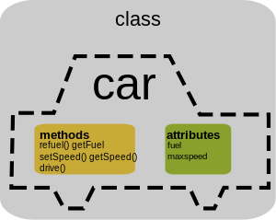

Slide 11
Classes
A class is the blueprint from which individual objects are created:
[access modifier] class classIdentifier
[extends Superclass]
[implements interfaceIdentifier1, interfaceIdentifier2 etc.] {
[variables]
[constructors]
[methods]
[annotations]
}

Slide 12
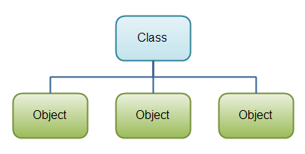

Slide 13
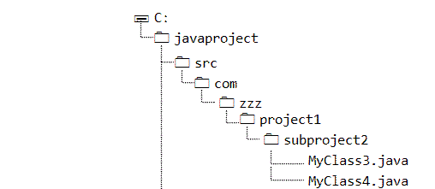
Packages
2.3

Slide 14
Packages
A package is a namespace that organizes a set of related classes and interfaces and an effective mechanism when the size of your application grows.
The Java SDK is categorized in various packages. For example, java.lang provides basic language functionality and fundamental types, and java.io can be used to carry out file-related operations.
Statements:
package package_name
import package_name

Slide 15
Access modifiers
2.4

Slide 16
Access modifiers
Java supports four types of access modifiers:
Private
Default (no access modifier specified)
Protected
Public

Slide 17
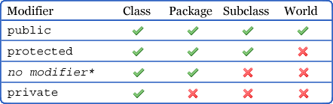

Slide 18
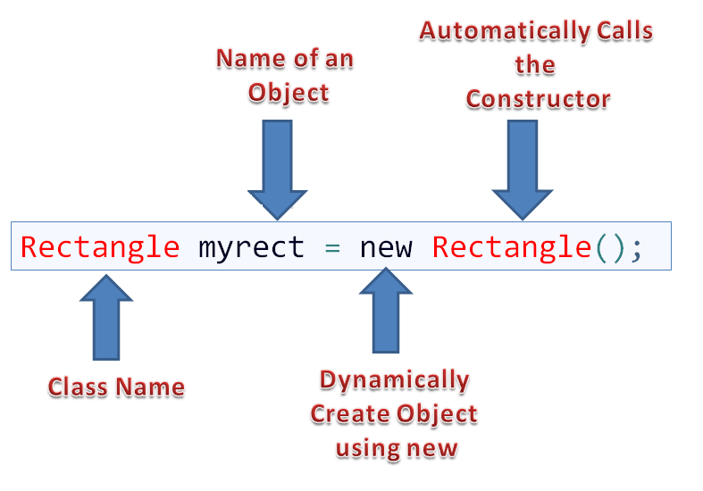
Constructors
2.5

Slide 19
Constructors
Each time you create an object, a constructor of that class gets called.
The main rule of constructors is that they should have the same name as the class.
A class can have more than one constructor.
Explicit constructor : defined by user
Implicit constructor: default constructor provided by JVM

Slide 20
Interfaces
2.6

Slide 21
Interfaces
A special type of class that has the following properties:
cannot be instantiated
supports multiple inheritance
variables can only be final and static
does not contain any constructors
all methods declared are implicitly considered to be abstract
only public access is allowed for members of an interface

Slide 22
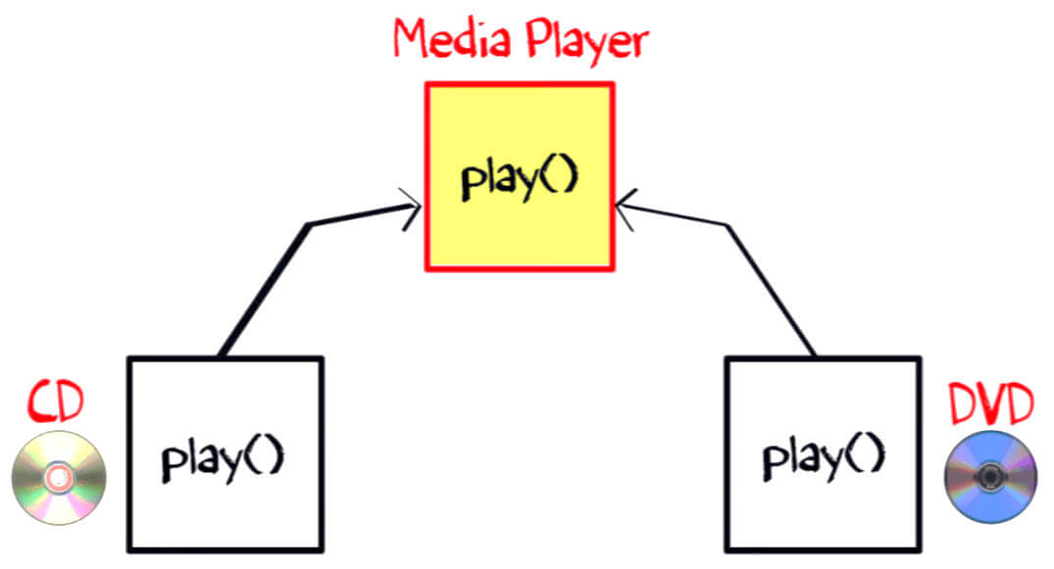
Interfaces

Slide 23
Abstraction
2.7

Slide 24
Abstraction
Abstract classes:
cannot be instantiated
can contain abstract methods
Abstract methods:
have a method signature but no method body
any child class must either override the abstract method or declare itself abstract

Slide 25
Encapsulation
2.8

Slide 26
Encapsulation
Encapsulation is the technique of making the fields in a class private and providing access to the fields via public methods.
The main benefit of encapsulation is the ability to modify our implemented code without breaking the code of others who use our code.

Slide 27
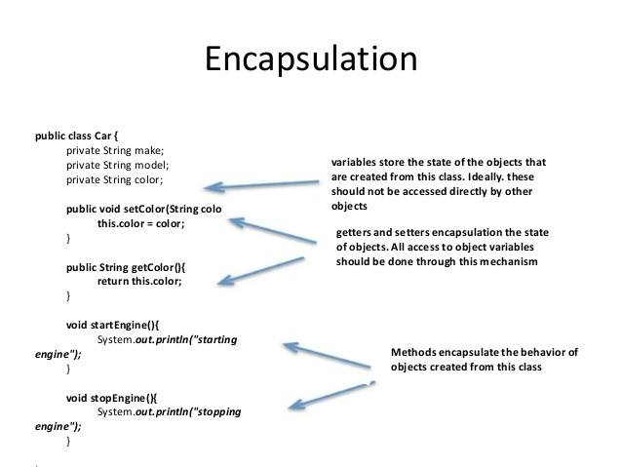

Slide 28
Inheritance
2.9

Slide 29
Inheritance(1)
Inheritance is a reusability mechanism in object-oriented programming in which the common properties of various objects are exploited to form relationships with each other.

Slide 30
Inheritance(2)
When we say that a class B is inherited from another class A, then class B is referred to as a derived class (or subclass) and class A is called as a base class (or superclass).
By inheritance, the derived class receives the behavior of the base class, such that all the visible member methods and variables of the base class are available in the derived class.

Slide 31
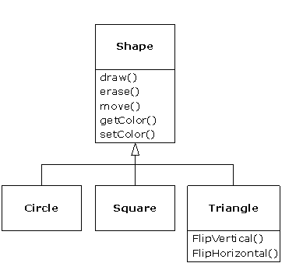

Slide 32

Polymorphism
2.10

Slide 33
Polymorphism
Polymorphism is the ability of an object to take on many forms.
The most common use of polymorphism in OOP occurs when a parent class reference is used to refer to a child class object.

Slide 34
class Shape{
void draw(){System.out.println("drawing...");}
}
class Rectangle extends Shape{
void draw(){System.out.println("drawing rectangle...");}
}
class Circle extends Shape{
void draw(){System.out.println("drawing circle...");}
}
class Triangle extends Shape{
void draw(){System.out.println("drawing triangle...");}
}
class TestPolymorphism2{
public static void main(String args[]){
Shape s;
s=new Rectangle();
s.draw();
s=new Circle();
s.draw();
s=new Triangle();
s.draw();
}
}

Slide 35
Method overloading
2.11

Slide 36
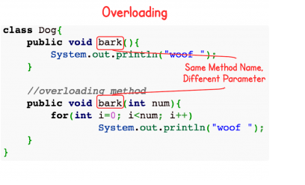
Method overloading (Static polymorphism)
Method overloading in Java occurs when two or more methods in the same class have the exact same name but different parameters.
Another important point to remember is that overloading is a compile time phenomenon.

Slide 37
Method overriding
2.12

Slide 38
Method overriding (Dynamic polymorphism)
Overriding methods is completely different from overloading methods.
If a derived class requires a different definition for an inherited method, then that method can be redefined in the derived class.
An overridden method would have the exact same method name, return type, number of parameters, and types of parameters as the method in the parent class.
Another important point to remember is that overriding is a run time phenomenon.

Slide 39
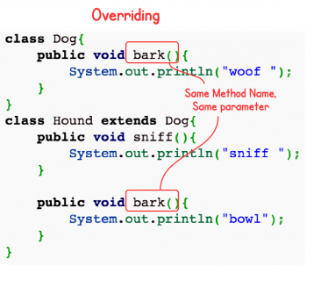
Method overriding

Slide 40
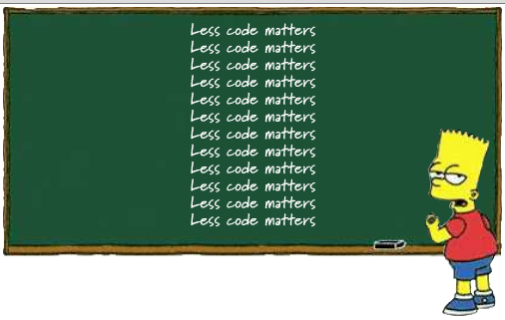
D.R.Y. principle
3

Slide 41
D.R.Y. (Do not repeat yourself)
DRY is a principle of software development that is stated as:
“Every piece of knowledge must have a single, unambiguous, authoritative representation within a system.”
Examples:
Abstraction principle
Code reuse
Single Source of Truth
Rule of three

Slide 42
Immutable objects
4

Slide 43
Immutable objects(1)
Immutable objects are simply objects whose state (the object's data) cannot change after construction.
Examples of immutable objects from the JDK include String and Integer, Long, Double, Float.

Slide 44
Immutable objects(2)
You can make a class immutable by following these guidelines:
do not provide any methods which can change the state of the object in any way (e.g. setters)
make fields private and final
ensure the class cannot be overridden - make the class final or use private constructors
if the class has any mutable object fields, then they must be defensively copied when they pass between the class and its caller

Slide 45
Thank you!

Slide 46
Questions?

